Slide 1

Highly Interpretable Graph NNs for Real World Multi-Agent Systems
Alex Beyer
Department of Mechanical Engineering
University of Maryland
abeyer@umd.edu

Slide 2
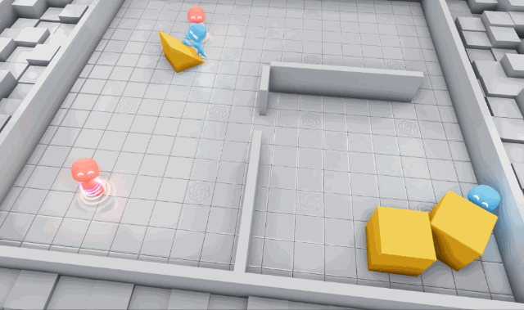
Why Study Multi-Agent Systems?
Multi-Agent (MA) Systems are collections of agents that solve complex problems via coordinated action
Studying these systems also gives insights on emergent group behaviors
MA Systems are all around us!
Self Driving Cars
Site/Project Monitoring[1]
Image: openai.com/research/emergent-tool-use

Slide 3
Real-World Requirements for MA Systems
Requirement | Definition
Performance | Algorithms must be capable of accurately performing the given task
Interpretability | Algorithms must be able to provide human understandable rationale for actions taken, ideally allowing designers to step through the logic used
Fault Tolerance | MA Systems should maintain performance and safety even as communication quality varies or agents cease functioning
Extensibility | Algorithms should account minor changes in the problem (such as number of agents or changes in constraints) without much work
Transferability | Ideally, a MA framework should be able to handle a variety of problems
Definitions based on the work of [7-9]

Slide 4
State of the Art for MA Systems
Two main approaches:
Expert Designed, Model Based Control
Multi-Agent Reinforcement Learning (MARL)
Often makes use of Deep Reinforcement Learning (DRL)
Other major considerations:
Centralization vs Decentralization
Communication
Notes:
Explain DRL here and say we don’t have time to go much into depth – uses ANNs to solve problems involving high dimensional data with complicated rules governing outputs, its great for solving complex problems because it requires comparatively little engineering of its features but the high dimensionality of the network and sheer number of operations involved make it difficult to interpret

Slide 5
Model Based Control
Uses models of system dynamics to derive optimal control laws
Provides robust guarantees of system behavior
Often Constraint-Driven, having been demonstrated for
Collision free navigation via Barrier Functions[2]
Platooning of vehicles on highways[3]
Predator avoidance and emergent flocking[4]

Slide 6
Example: Safety Barrier Certificates

Slide 7
Example: Predator Avoidance and Flocking

Slide 8
Multi-Agent Reinforcement Learning
Many algorithms used such as:
Decentralized Partly Observable Markov Decision Processes(Dec-POMDPs)[6]
Graph Neural Networks (GNNs)[5]
Decentralized Asynchronous Advantage Actor-Critic (A3C)[6]
Evolutionary Algorithms
Also need to consider:
Centralized vs. Decentralized Learning
Communication Strategy
Problem Decomposition

Slide 9
Multi-Agent Reinforcement Learning
Many algorithms used such as:
Decentralized Partly Observable Markov Decision Processes(Dec-POMDPs)[6]
Graph Neural Networks (GNNs)[5]
Decentralized Asynchronous Advantage Actor-Critic (A3C)[6]
Evolutionary Algorithms
Also need to consider:
Centralized vs. Decentralized Learning
Communication Strategy
Problem Decomposition

Slide 10
MARL Vs. Model Based Control
Both methods have advantages
Both are highly performant and can be fault tolerant
MARL is highly extensible and transferable
Model-Based Control is readily interpretable
However, there are also inherent drawbacks
Use of DRL for MARL approaches makes interpretability difficult
Classical Control Design leads to solutions which often transfer and can extend poorly
Notes:
Need to really motivate why Im choosing to go with MARL over traditional design here – the issues w classical design are inherent to the approach whereas there is a lot of reason to think that the issues in MARL are due to a lack of development

Slide 11
Model Interpretability - Dimensions
Many metrics are difficult to quantify and there’s no definitive set!
Requirement | Definition
Transparency | Choosing model representations which have well understood properties and intuitive representation of different features
Simulatability | The ability to break a model into subsystems with understandable inputs and outputs
Decomposability | Understanding the way model components process data
Saliency | Identifying why a given input maps to a given output
Consistency | Similar inputs should lead to similar outputs
Based on work of [7,8,11]

Slide 12
MARL Interpretability – State of the Art
Many methods have been used such as
Imitation Learning of Proxy Models[12]
Example Based Explanations[5,11]
Specific Model and Objective Design[6,11]
GNNs offer two main advantages for Decentralized MA Systems
Transparent Representations of Data[13]
Easy to Decentralize[14]
Notes:
[5,6,12,13]

Slide 13
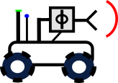
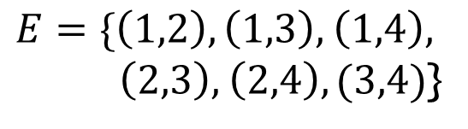
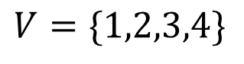
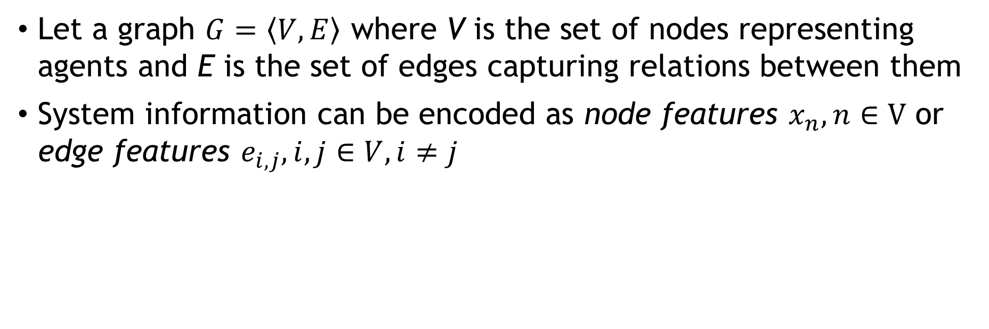
Intro to Graphs and Graph Theory
Let a graph $G=\left\langle V,E\right\rangle$ where V is the set of nodes representing agents and E is the set of edges capturing relations between them
System information can be encoded as node features $x_{n},n∈V$ or edge features $e_{i,j},i,j∈V,i≠j$
2
$$V=\{1,2,3,4\}$$
1
$E=\{\left(1,2\right),\left(1,3\right),$ $\left(1,4\right),$
$\left(2,3\right),$ $\left(2,4\right),(3,4)$}
3
4
See [10] for full explanation

Slide 14
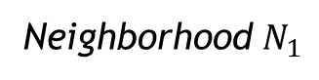
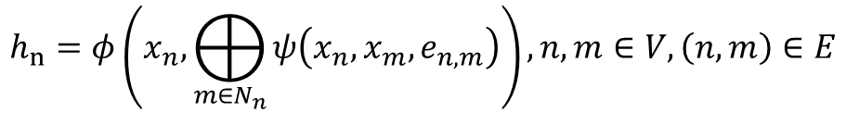
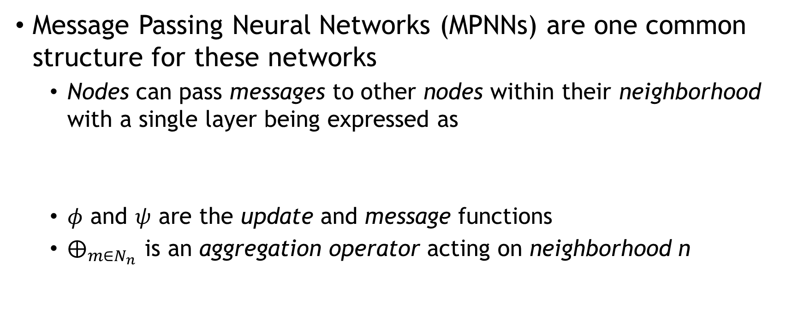
Intro to Graph Neural Networks
Message Passing Neural Networks (MPNNs) are one common structure for these networks
Nodes can pass messages to other nodes within their neighborhood with a single layer being expressed as
$φ$ and $ψ$ are the update and message functions
$⨁_{m∈N_{n}}{ }$is an aggregation operator acting on neighborhood n
$$h_{n}=φ\left(x_{n},⨁_{m∈N_{n}}{ψ\left(x_{n},x_{m},e_{n,m}\right)}\right), n,m∈V,\left(n,m\right)∈E$$
Neighborhood $N_{1}$
1
2
4
3
5
See [10] for full explanation
Notes:
GNNs first conceptualized in 2005, little progress was made with them until Kipf et al presented their work on Graph Convolutional Networks in 2017, sparking renewed interest

Slide 15
Example: Decentralized GNN based Exploration

Slide 16
Highly Interpretable Graph NNs for Real World Multi-Agent Systems
Problem: MARL approaches lack the interpretability needed for safe implementation in real world human environment

Slide 17
Highly Interpretable Graph NNs for Real World Multi-Agent Systems - Approach
Equipment
Fleet of Unmanned Vehicles with communications and processing hardware
Unmanned drones with similar hardware for heterogeneity tests
Proposed GNN Application
Coordinating Inter-Agent Communication for Pathfinding in Partially Observable Environments
Agents are equipped with necessary low-level controllers to facilitate motion
Notes:
Communication coordination is one of the more common applications of GNNs for MARL

Slide 18
Highly Interpretable Graph NNs for Real World Multi-Agent Systems - Timeline
Year 1, Q1-2
Develop and verify interpretability metrics
Year 1, Q3-4
Deployment in unstructured but controlled real world settings
Year 2
Extend to more realistic, totally unstructured human environments
Tests in simulation and structured lab environments
Comparison against existing state-of-the-art metrics
Rigorously verify that interpretability is maintained in more complex environments
Begin controlled Human-Robot interaction tests to ensure safety and robustness of metrics
Slowly allow more uncontrolled interactions to test model limits
Develop robust, interpretable model failsafes
Ensure all failsafes work as intended
Recheck all failsafes before allowing for more interaction between humans and agents
Apply metrics to real world heterogenous systems
Review of relevant literature to identify state of the art GNN architectures and current best methods for improving DRL and NN Interpretability
Develop frameworks for Centralized Training with Decentralized Execution (CTDE) and Decentralized Training and Execution (DTDE)
Reverify performance in CTDE and DTDE regimes

Slide 19
Conclusions

Slide 20
References
tinyurl.com/ABQERefs
[1] L. Xiang, Y. Tan, G. Shen, and X. Jin, “Applications of multi-agent systems from the perspective of construction management: A literature review,” Eng. Constr. Archit. Manag., vol. 29, no. 9, pp. 3288–3310, Nov. 2022, doi: 10.1108/ECAM-01-2021-0038.
[2] L. Wang, A. D. Ames, and M. Egerstedt, “Safety Barrier Certificates for Collisions-Free Multirobot Systems,” IEEE Trans. Robot., vol. 33, no. 3, pp. 661–674, Jun. 2017, doi: 10.1109/TRO.2017.2659727.
[3] L. E. Beaver and A. A. Malikopoulos, “Constraint-Driven Optimal Control of Multi-Agent Systems: A Highway Platooning Case Study,” IEEE Control Syst. Lett., vol. 6, pp. 1754–1759, 2022, doi: 10.1109/LCSYS.2021.3133801.
[4] L. E. Beaver and A. A. Malikopoulos, “Constraint-Driven Optimal Control for Emergent Swarming and Predator Avoidance.” arXiv, Mar. 21, 2022. Accessed: Mar. 02, 2023. [Online]. Available: http://arxiv.org/abs/2203.11057
[5] Z. Ye, X. Jiang, G. Song, and B. Yang, “Soft Hierarchical Graph Recurrent Networks for Many-Agent Partially Observable Environments.” arXiv, Sep. 05, 2021. Accessed: Mar. 03, 2023. [Online]. Available: http://arxiv.org/abs/2109.02032
[6] G. Sartoretti, W. Paivine, Y. Shi, Y. Wu, and H. Choset, “Distributed Learning of Decentralized Control Policies for Articulated Mobile Robots,” IEEE Trans. Robot., vol. 35, no. 5, pp. 1109–1122, Oct. 2019, doi: 10.1109/TRO.2019.2922493.
[7] C. Glanois et al., “A Survey on Interpretable Reinforcement Learning.” arXiv, Feb. 24, 2022. Accessed: Mar. 02, 2023. [Online]. Available: http://arxiv.org/abs/2112.13112
[8] F.-L. Fan, J. Xiong, M. Li, and G. Wang, “On Interpretability of Artificial Neural Networks: A Survey,” IEEE Trans. Radiat. Plasma Med. Sci., vol. 5, no. 6, pp. 741–760, Nov. 2021, doi: 10.1109/TRPMS.2021.3066428.
[9] M. Dorigo, G. Theraulaz, and V. Trianni, “Reflections on the future of swarm robotics,” Sci. Robot., vol. 5, no. 49, p. eabe4385, Dec. 2020, doi: 10.1126/scirobotics.abe4385.
[10] M. M. Bronstein, J. Bruna, T. Cohen, and P. Veličković, “Geometric Deep Learning: Grids, Groups, Graphs, Geodesics, and Gauges.” arXiv, May 02, 2021. Accessed: Mar. 07, 2023. [Online]. Available: http://arxiv.org/abs/2104.13478
[11] Y. Zhang, P. Tiňo, A. Leonardis, and K. Tang, “A Survey on Neural Network Interpretability,” IEEE Trans. Emerg. Top. Comput. Intell., vol. 5, no. 5, pp. 726–742, Oct. 2021, doi: 10.1109/TETCI.2021.3100641.
[12] J. Blumenkamp and A. Prorok, “The Emergence of Adversarial Communication in Multi-Agent Reinforcement Learning”.
[13] J. Sheng et al., “Learning structured communication for multi-agent reinforcement learning,” Auton. Agents Multi-Agent Syst., vol. 36, no. 2, p. 50, Oct. 2022, doi: 10.1007/s10458-022-09580-8.
[14] J. Blumenkamp, S. Morad, J. Gielis, Q. Li, and A. Prorok, “A Framework for Real-World Multi-Robot Systems Running Decentralized GNN-Based Policies,” in 2022 International Conference on Robotics and Automation (ICRA), Philadelphia, PA, USA, May 2022, pp. 8772–8778. doi: 10.1109/ICRA46639.2022.9811744.

Slide 21
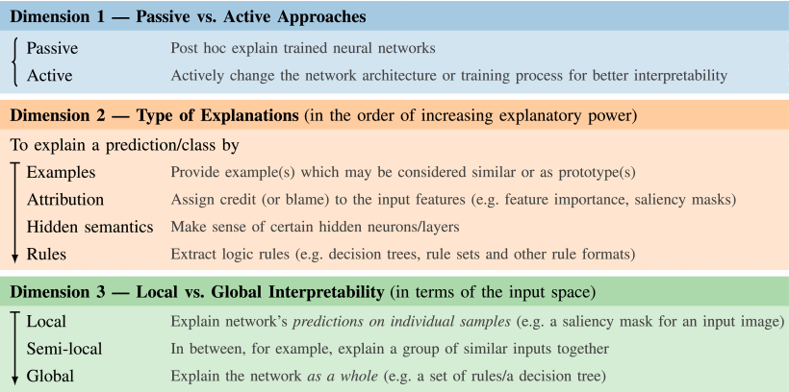
Model Interpretability - Taxonomy
Based on work of [7,8,11]

Slide 22
Agent Heterogeneity
Based on work of [7,8,11]

